Slide 1
What is a basemap?
Is ‘hamburger cartography’ real?

Slide 2
Today’s Outline
Review
  Final Projects, any questions!?
(Web) Basemaps in history
(Web) Basemaps today
Exercise: Loading a custom tileset

Slide 3
Cobbling tools and ideas together
How javascript, css, and html work together
  Html builds the DOM (it structures and contains the content)
  Css styles what is displayed (what color, what size, and so on)
  Javascript makes it interactive and dynamic (what happens when you scroll, if you click here, etc.)
How various web technologies and tools work together
  Leaflet is a javascript mapping library (that also comes with its own css)
  Hamburger cartography!
Gaining familiarity with implementing and styling interactive maps
Gaining an ability to understand how more advanced visualizations are created
  What technologies do they use?
  How do those fit together?
Learning to read documentation, use examples, and leverage all of the above

Slide 4
Leaflet is a javascript mapping library
Libraries are pre-written bundles of code
  The contain… functions, methods, objects (classes), etc.
Javascript has many built in functions, methods, classes, and so on
  But, can’t contain everything that could be coded…
Libraries simplify and speed up development
  You don’t need to reinvent the wheel every time!
  They allow for people to specialize in areas that interest them!
In many ways, libraries are at the core of open-source development

Slide 5
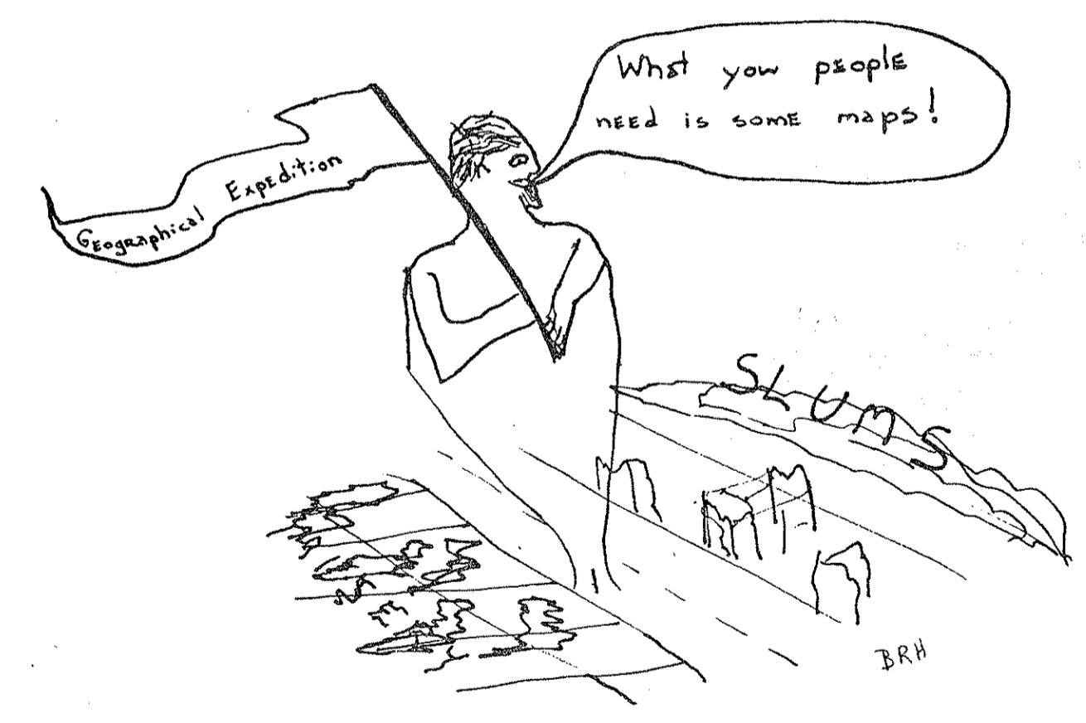
Considerations of map design?

Slide 6
Hamburger Style
Base Map
Data Layers
Interactivity
Does a web map need all three?

Slide 7
What did we learn?
A map on the web isn’t necessarily a web map?
Hamburger cartography isn’t necessary for a web map?
Interactivity isn’t necessary for a web map?
No, so what did we learn?
  You can look up definitions, there are many; but, you can find exceptions to each.

Slide 8
Final Projects
20 or 30 points
  2 points for proposal
  6 (472) or 12 (572) points for the write up
  12 (472) or 16 (572) points for the visualization
Topic Proposal due Friday, February 16th
  On canvas
Project due Friday, March 18th by 11:59pm
  Write up on canvas
  Other elements through github, canvas, etc. (as appropriate for individual projects)

Slide 9
Final Projects - Topic Proposal
3-5 sentences (a paragraph) describing what you are going to do.
Must include:
  A description of what will be produced (1-2 sentences)
    “My project will create a leaflet web visualization that…”
    “My project will create an interactive tool that…”
  The expected technologies/tools you will use (1-2 sentence)
    “I will make use of leaflet, cesium, and p5.js to…”
    Do not include things like “javascript” and “css” - those are assumed.
  Some expected sources of data (1-2 sentences)
    “I will make use of OpenStreetMap and USGS data…”
Due February 16th at 5pm on canvas

Slide 10
Final Projects - Visualization
Make something using the tools and techniques introduced in this class and that you’ve discovered on your own
Be creative and push yourself
It must be:
  Fully functional and hosted independently
    In other words, use github.io (or another source) to create a web page I can load from an internet connection (if there are specific reasons this is impossible, we can discuss)
  Involve at least one geospatial visualization (‘web map’)
This is not an opportunity to put points on a leaflet map and call it a day.
  If you’re having trouble, come talk to me!

Slide 11
Final Projects - Written Portion
472: 500-1k words; 572: 1k-2k words.
A recounting of what you did, why, what did and didn’t work, and what you learned.
An outline might look like this (you need not follow it):
  Intro - introduce the topic, explain the reasoning, lay out what you set out to do.
  ‘Lit Review’ (in quotes!) - Why does this topic matter? What resources did you consult?
  Methods - What you did and how. Data sources used, libraries consulted, etc.
  Reflection/Discussion - What worked, what didn’t
  Conclusion - Tell me what you learned and why it mattered. If you were to do more, what would the next step(s) be?

Slide 12
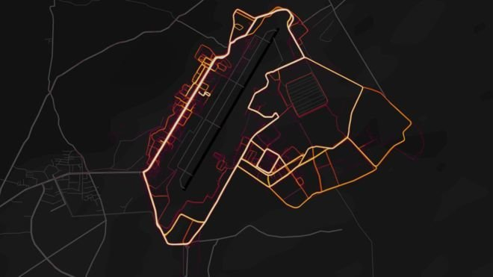
The secret?
Notes:
This actually is a web map, but i’ve taken a static image here.

Slide 13
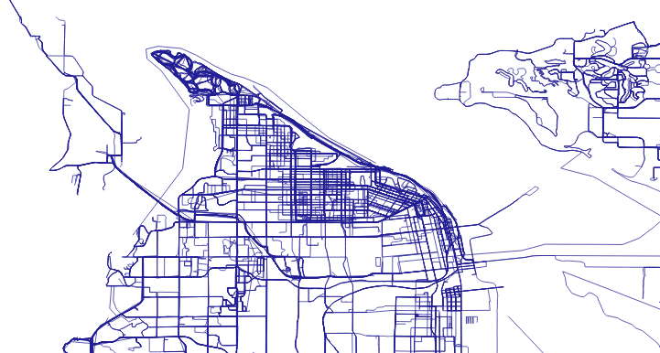
The secret?
Notes:
This actually is a web map, but i’ve taken a static image here.

Slide 14
Maps are powerful. But, that doesn’t always mean they’re appropriate or helpful.

Slide 15
Hamburger Style
Base Map
Data Layers
Interactivity
Does a web map need all three?

Slide 16
So many definitions!
ESRI documentation:
  “Basemaps serve as a reference map on which you overlay data from layers and visualize geographic information. An individual basemap can be made of multiple feature, raster, or web layers. Basemaps are the foundation for your maps and provide context for your work.”
Merriam Webster’s dictionary:
  ”a map having only essential outlines and used for the plotting or presentation of specialized data of various kinds”
Geospatial World:
  “ A map contains different layers of data with geographic information that serves as a background, called a basemap. A basemap provides context for additional layers overlaid on the reference map. It usually provides location references for features like boundaries, rivers, lakes, roads, and highways.”
… and so on.

Slide 17
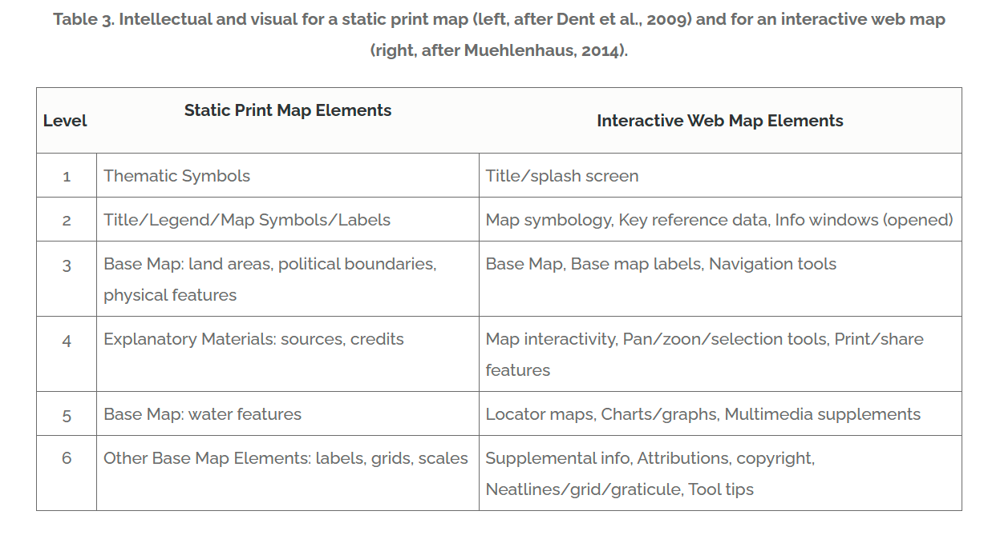
So many definitions!
Notes:
CV-07 - Visual Hierarchy and Layout | GIS&T Body of Knowledge (ucgis.org)

Slide 18
One last note… (or two)
GIST - “Web GIS”:
  “ Decoupling the base map from the thematic layers allows clients to re-use base maps in many applications, or employ base maps from well-known third parties, such as Google Maps. The term “mashup” is often used to describe a map created from two or more web services in this way.”
GIST - “Map Projections”:
  When designing maps for distribution online, there are often limited options for selecting the projection for a given map. If the data is ‘mashed up’ onto an existing tiled basemap, the projection is likely to be the Web Mercator projection, a variant on the Mercator projection. The Web Mercator is a nearly conformal projection, and thus, has been suggested as inappropriate for many small-scale thematic mapping purposes (see Battersby et al. 2014 for discussion). The use of Web Mercator for web mapping applications presents serious limitations for both spatial analysis and visual analysis. However, in current web mapping environments, projection choice is often limited.

Slide 19
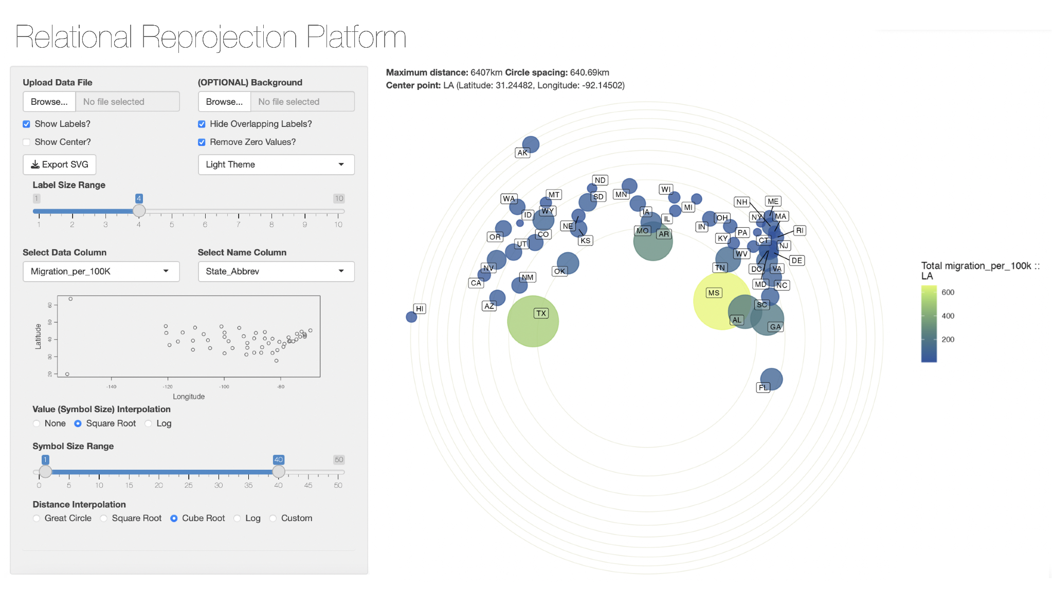
Where does that leave us?
Notice the wiggle room in many definitions (“many”, “most”, etc… but not all).
Charlie Frye:
  “The base map is the part of the map I don’t have to make.” To that, I say, who should make it, who will use it, and what will they do with it?”
Also, let’s go here just to see how cool this can get… https://philogb.github.io/page/myriahedral/

Slide 20
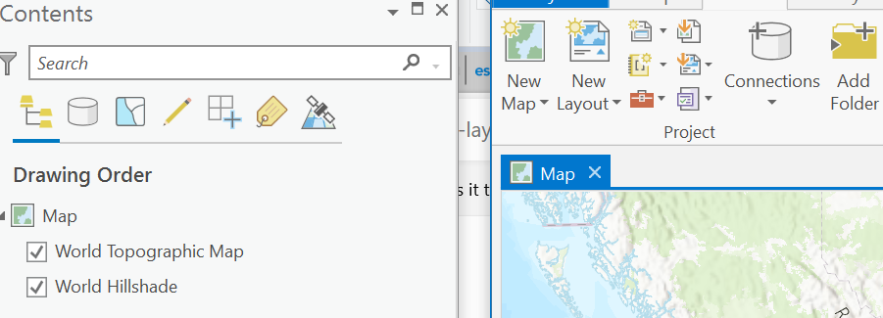
Where does that leave us?
Almost ‘two’ sorts of Base Maps:
  Broadly referring to the reference material that is not the focus of the map, but included to situate and orient the map reader.
    May or may not exist, may or may not be created for the specifci map
  The set of tiles on which data layers are placed in interactive (and increasingly ‘static’) cartography
    Usually present in ‘web maps’ (but not always!)
    For web maps, usually static tiles pre-rendered and loaded from ‘somewhere’

Slide 21
Where does that leave us?
In the coming weeks, we’ll style our own base maps, but - today - let’s take a look at some that are easily usable online.
Go here:
  https://leaflet-extras.github.io/leaflet-providers/preview/
Find a basemap (tileset) or two that you like and add them to leaflet maps…

Slide 22
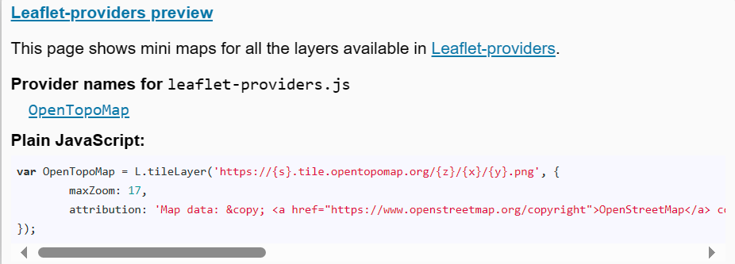
Copy some of this (but not all!)

Slide 23
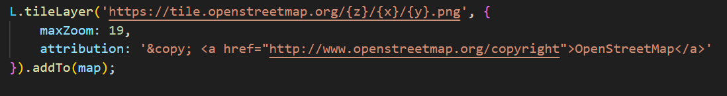
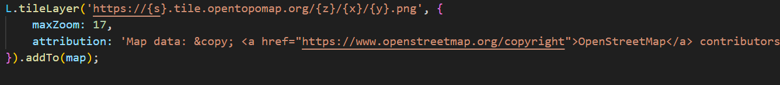

Slide 24
